Slide 1

Bitter Peptides in Dairy Products
We study the formation and impact of bitter peptides in dairy products, developing strategies to minimize bitterness while maintaining nutritional value.
Research focus:
Bitter peptide identification
Formation mechanisms
Mitigation strategies
Sensory impact assessment
Learn More

Slide 2
Functional Optimization of Ingredients and Processes

Slide 3
Bitter Peptides in Dairy Products

Slide 4
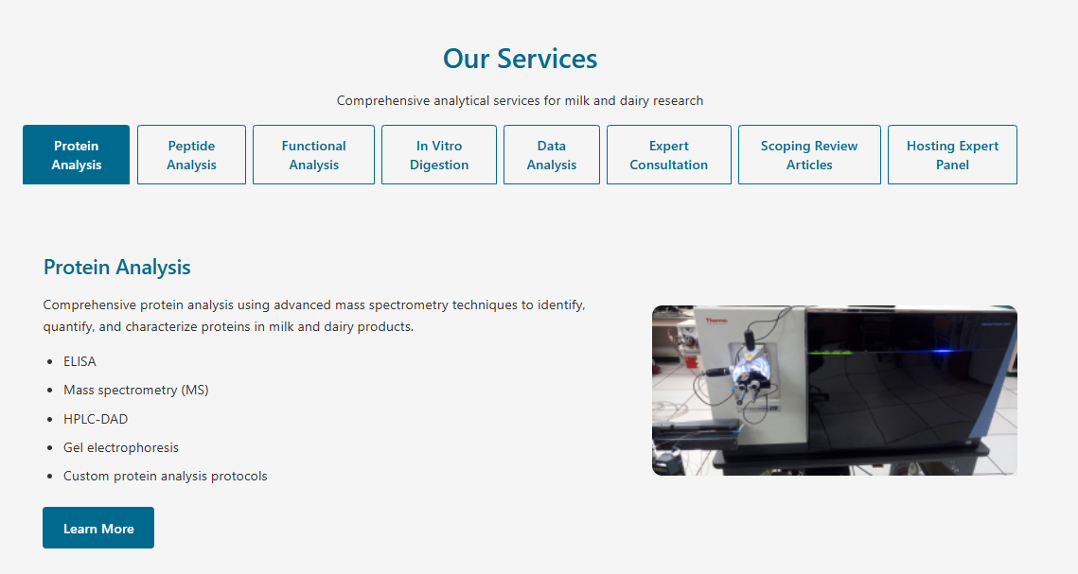

Slide 5
Expert Consultation
Expert guidance for project design, troubleshooting, and research strategy in milk and dairy science.
Project Design
Project Troubleshooting
Hosting a Panel
Scientific writing
Research strategy
Learn More

Slide 7
Hosting Expert Panel
Organizing and moderating expert panels on milk and nutrition topics, facilitating discussion among leading researchers and industry professionals.
Panel organization and moderation
Facilitating expert discussion
Panel reports and recommendations
Custom panel events available
Learn More

Slide 8
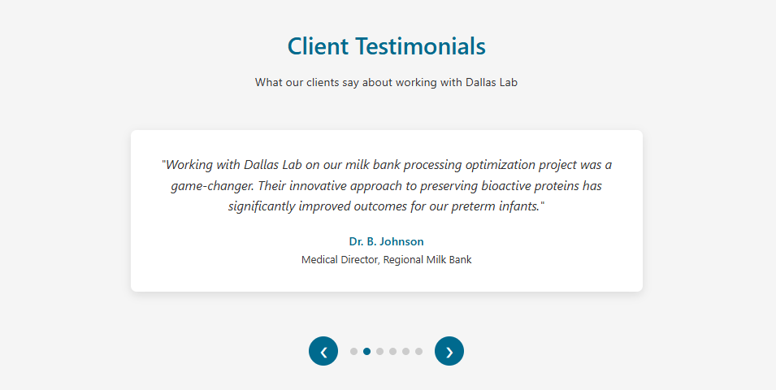

Slide 9
Functional Analysis

Slide 10
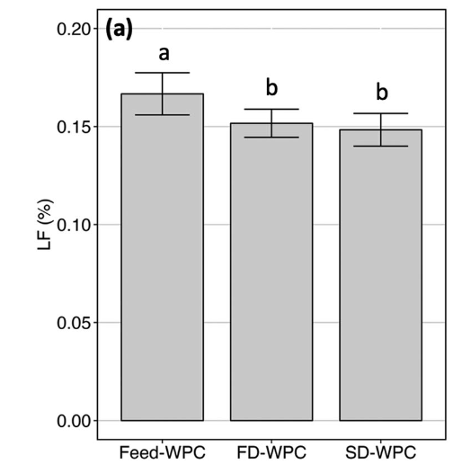
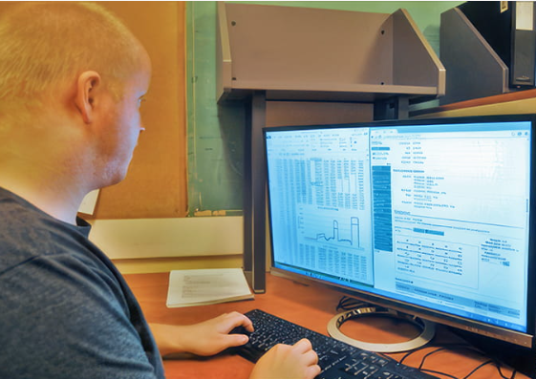
Data Analysis
Data Analysis
Comprehensive data analysis and reporting services to help you understand and utilize your results effectively.
Functional peptide annotation
Statistical analysis
Figure generation
16s bioinformatics
Custom data analysis projects
Learn More

Slide 11
Expert Consultation

Slide 12
Hosting Expert Panel

Slide 13
About Us
https://health.oregonstate.edu/research/dallas-lab/people

